Slide 1

PUBLIC MEETING
6 October 2002
COMMUNITY CONNECTIVITY GRANT PROGRAM
FOR
Main Street Sidewalk Connectivity Project

Slide 2
Public Comments
Within Zoom™ application “Raise Hand” if you would like to participate during Public Participation.
If calling into Zoom Meeting by telephone dial *(star) 9 to “Raise Hand” to be recognized.
Toll Free #’s (888) 788 0099 or (877) 853 5247
Webinar ID : 829 9046 8730#
Password: 649489#

Slide 3

Introduction
Town Engineer
Gary Fuerstenberg, PE
  860-665-8572
  gfuerstenberg@newingtonct.gov

Slide 4
Thank You
Town Manager
Engineering Staff
Planning Staff
Town Clerk

Slide 5
Community Connectivity Grant Summary
Connecticut Department of Transportation (CDOT)
Competitive application processes (169 Towns)
Small scale improvements
$125k to $600k per town
Improve pedestrian and bicycle safety and accessibility
Encourage healthy and sustainable modes of transportation
Facilitate social and economic opportunities
Construction activities only
Exclude engineering/design costs

Slide 6

Presentation Summary
Engineering Data
Planning Data
Existing Condition
Proposed Solution
Preliminary Design
Funding Sources
Schedule
Grant Application
Notes:
No corridor or background title page!

Slide 7
Project Origin

Slide 8
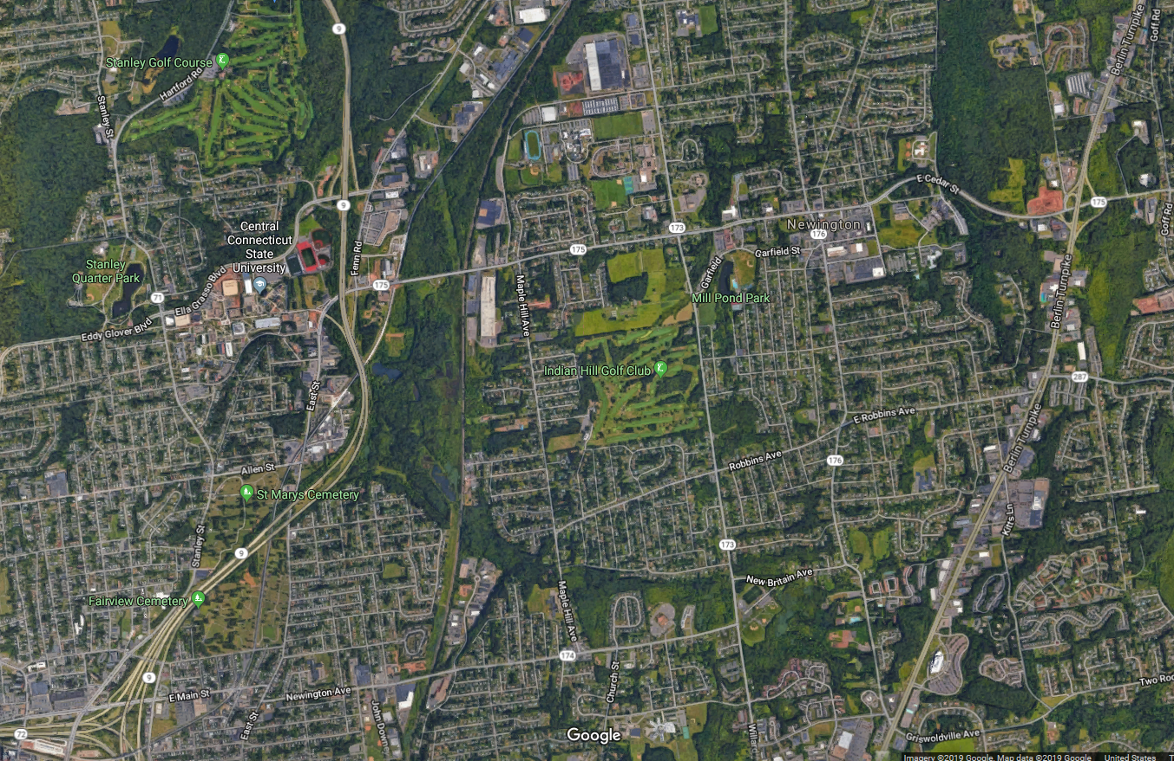
Project Corridor

Slide 9
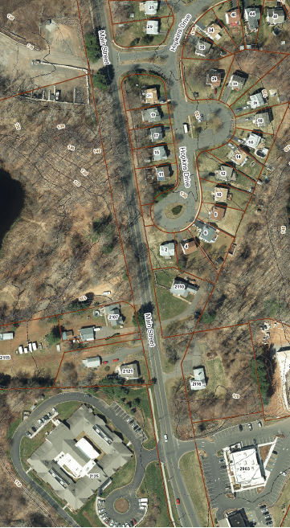
Corridor History
Former Landfill
Churchill Park
Abandoned I291 corridor
1995 – Hopkins Drive
  Hopkins Village
1997 Middlewoods
2018 – CDOT resurfaced
Sidewalk gap

Slide 10

ENGINEERING DATA
Notes:
TITLE PAGE

Slide 11
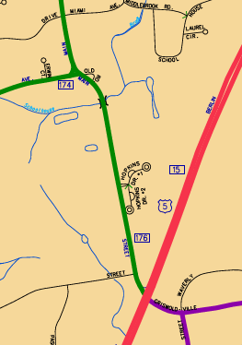
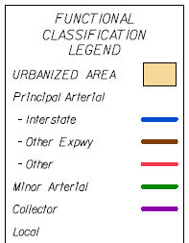
Road Classification
Minor Arterial (SR 176)

Slide 12
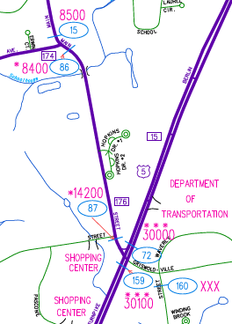
CDOT Traffic Data
Project Segment | ADT
Louis Street | 14,200
New Britain Avenue (SR 174) | 8,400
ADT = Average Daily Traffic, veh/day

Slide 13

PLANNING DATA
Notes:
TITLE PAGE

Slide 14

Complete Street Program
Facilitate multimodal transportation
Vehicles
Bicycles
Pedestrians
Increase quality of life
Increase property values

Slide 15
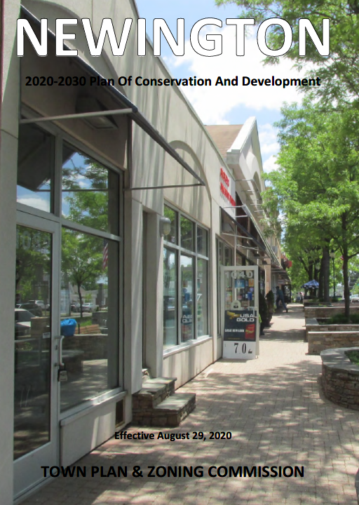
Plan of Conservation and Development
2020-2030
Town Planning and Zoning Commission
Pedestrian Plan
Bicycle Plan

Slide 16
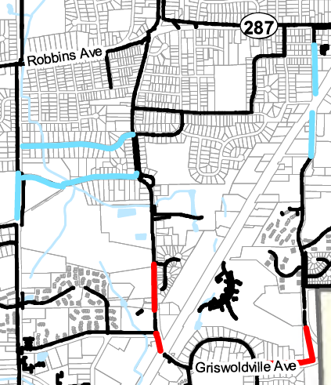
POCD – Pedestrian Plan
Extend sidewalks
Close sidewalk gaps
High priority sidewalk (red)
TON Project
CDOT Project 007-250

Slide 17
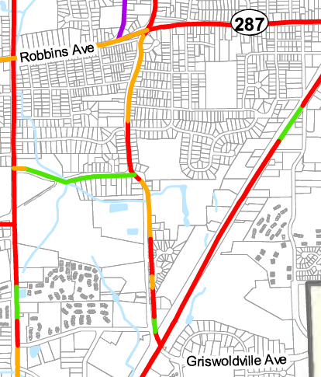
POCD – Bicycle Plan
Main Street (SR 176)
Not suitable for bicycles
High speed
Narrow pavement
Little to no shoulder
CDOT bicycle plan in TON = POCD

Slide 18
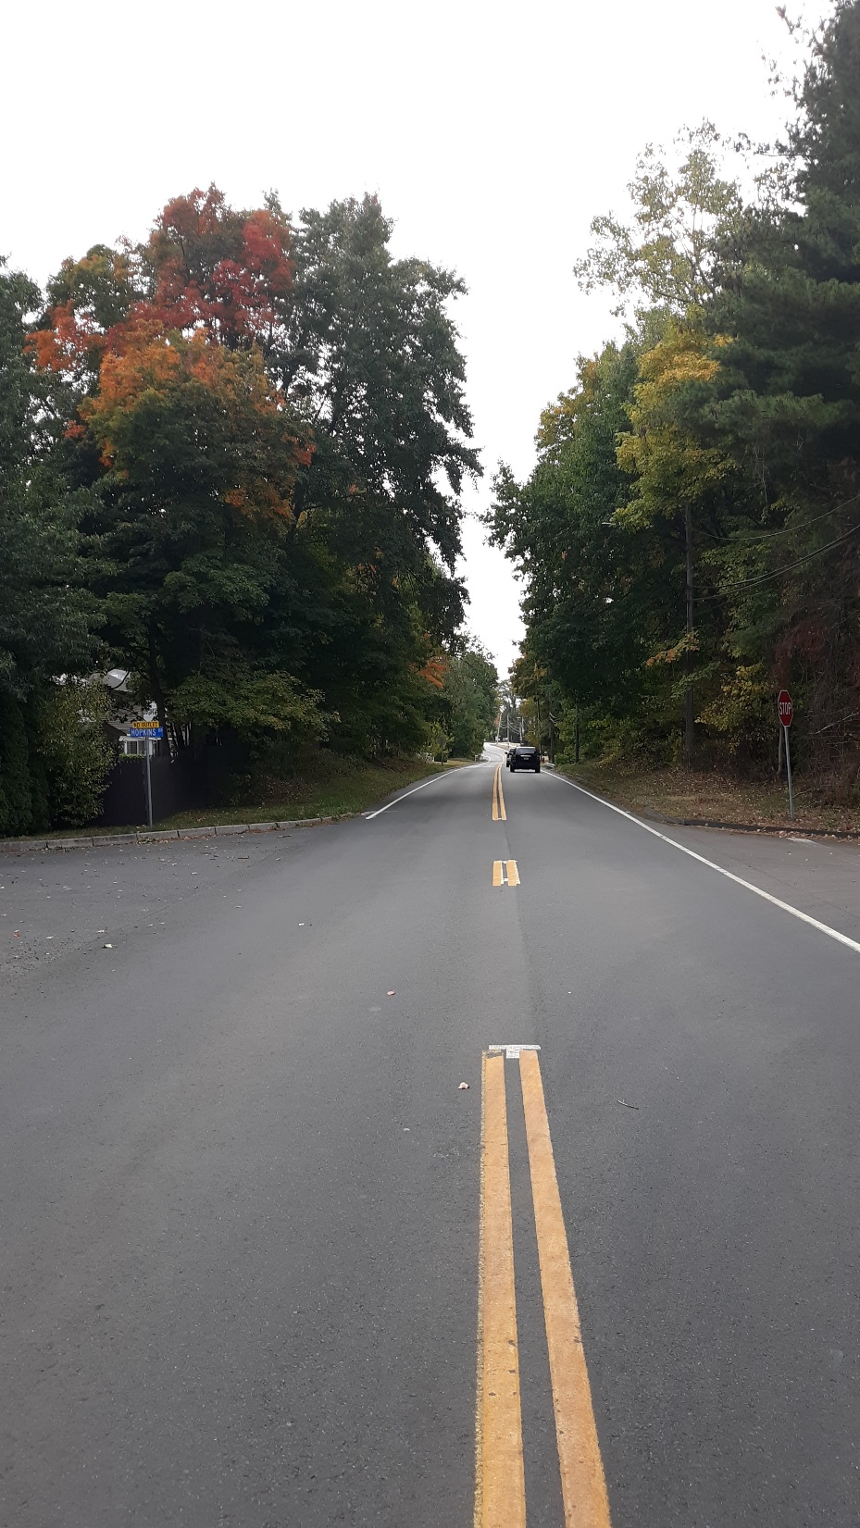
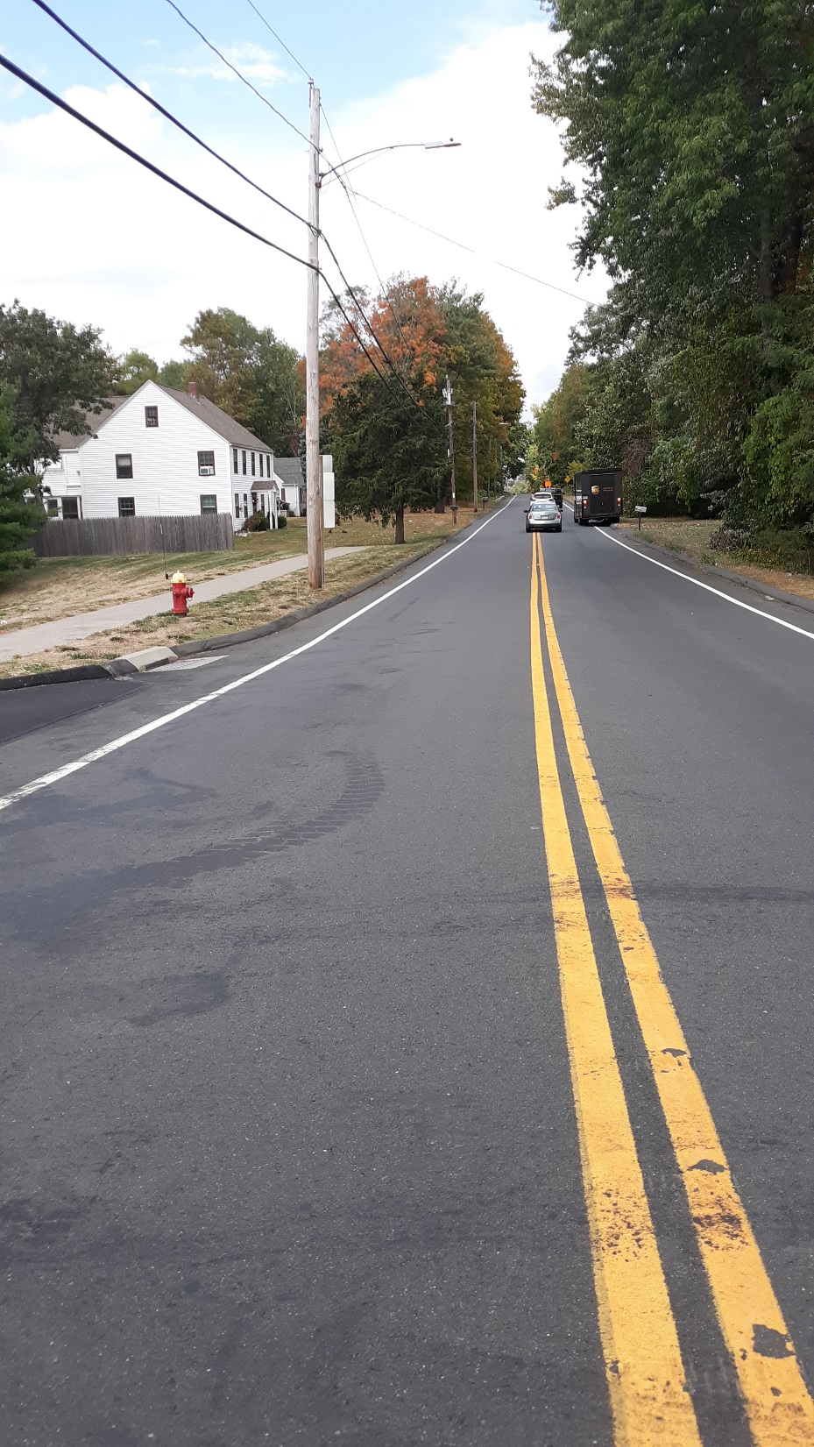
EXISTING
CONDITIONS
Notes:
TITLE SLIDE

Slide 19
Corridor Problems for Pedestrians
900’ Gap in Sidewalk Network
Unsafe for pedestrians to share the road with vehicles
High traffic volume (~10,000 VPD)
High Speed (40 MPH)
Narrow pavement
Little to no shoulder (1 to 2 feet)
Guiderail requires pedestrians to share road with vehicles
Uneven/steep ground requires pedestrians to share road with vehicles

Slide 20
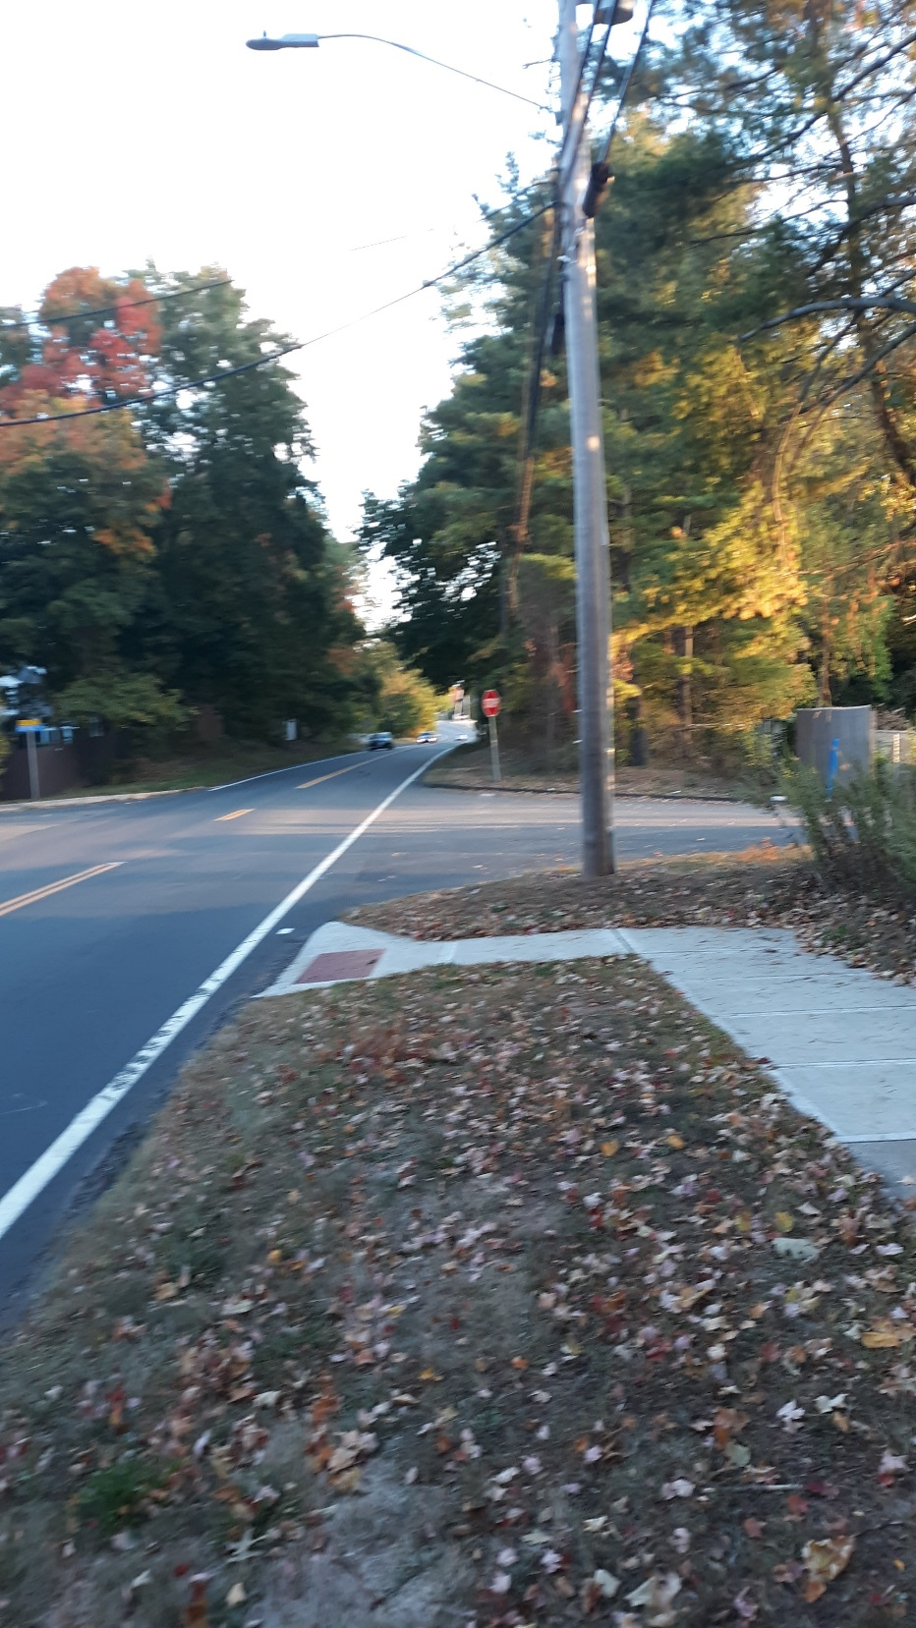
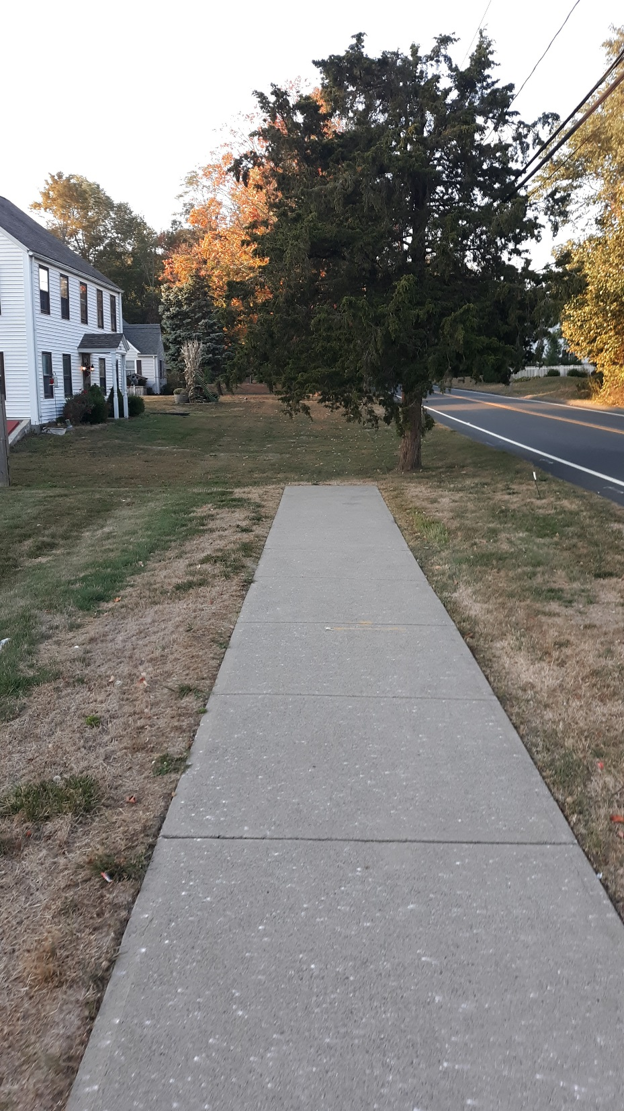
900’ Sidewalk Gap

Slide 21
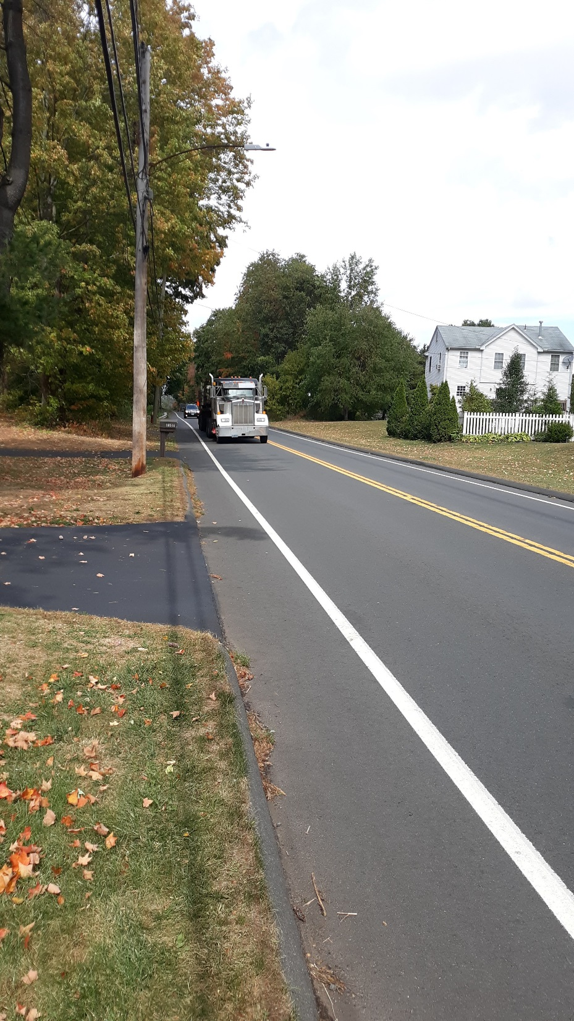
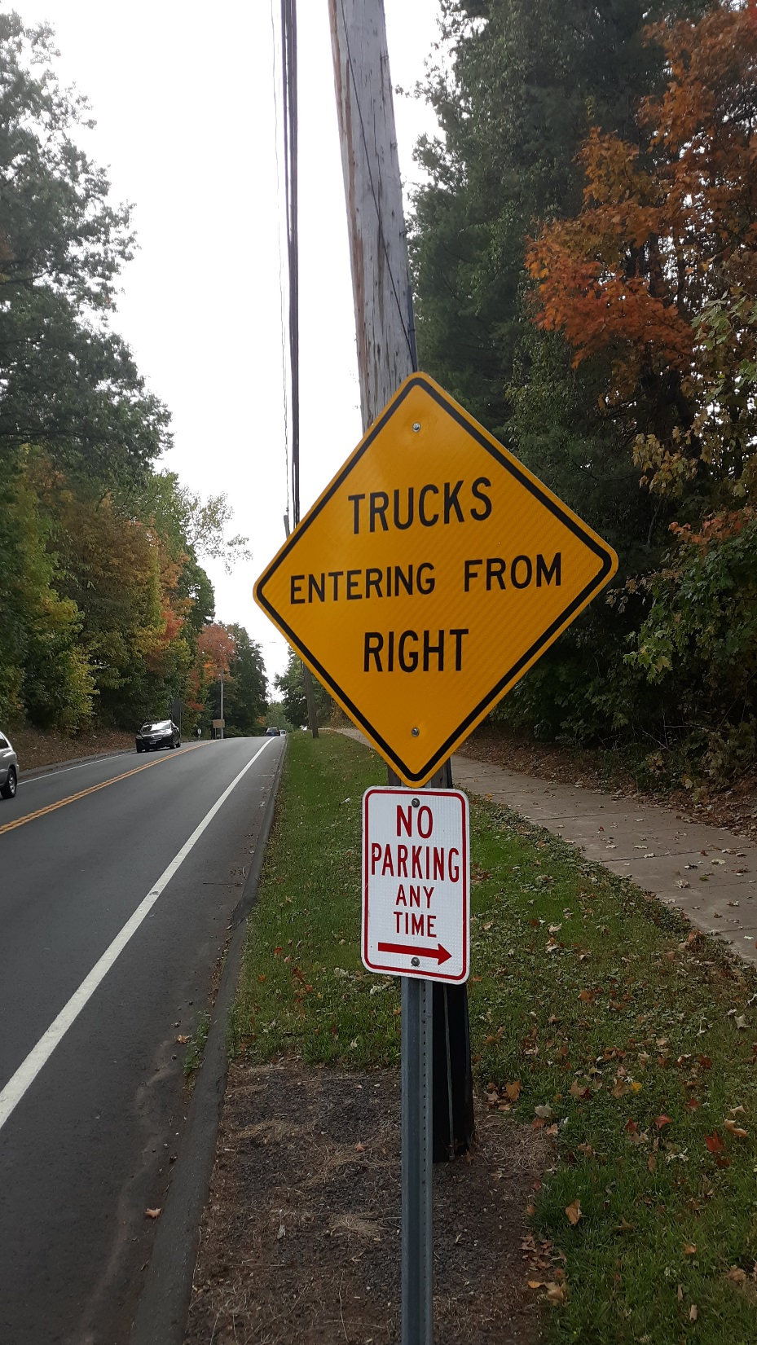
Trucks and Pedestrians Share Roadway

Slide 22
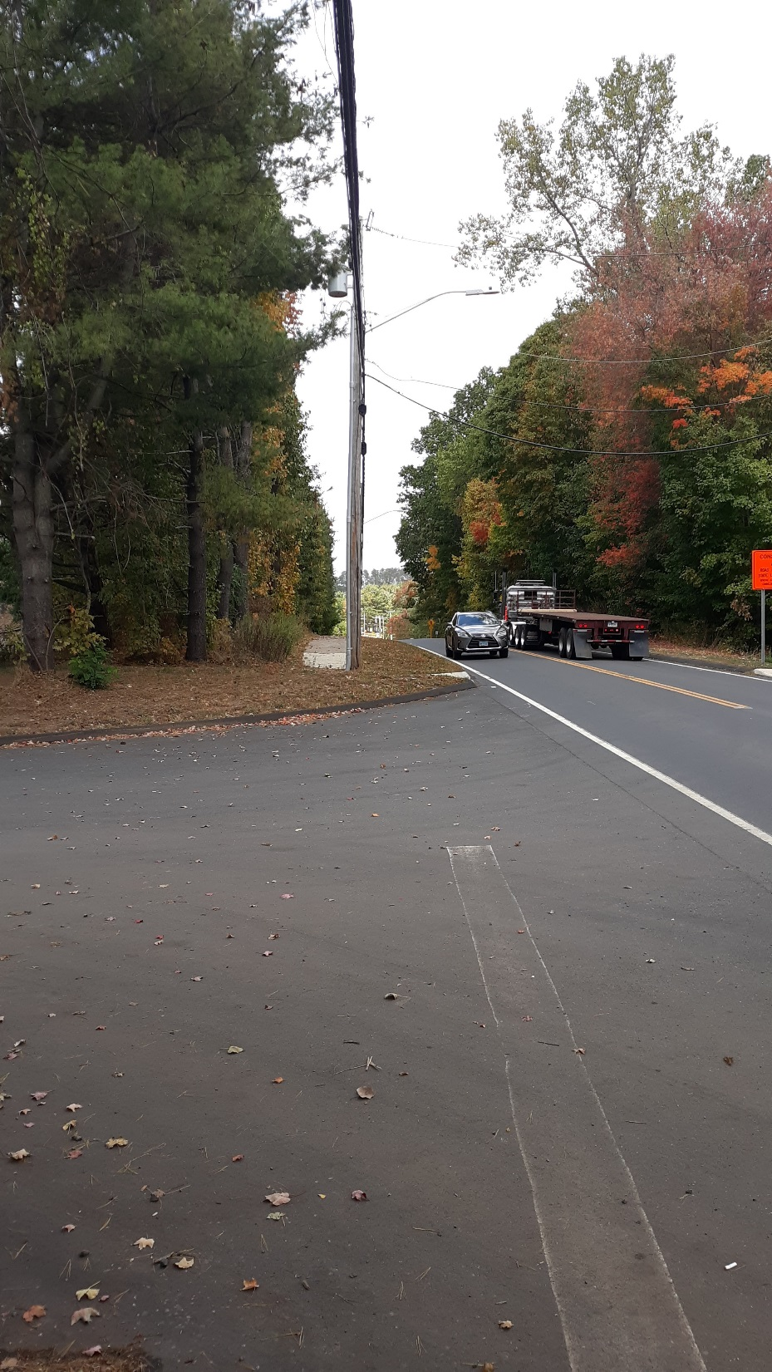
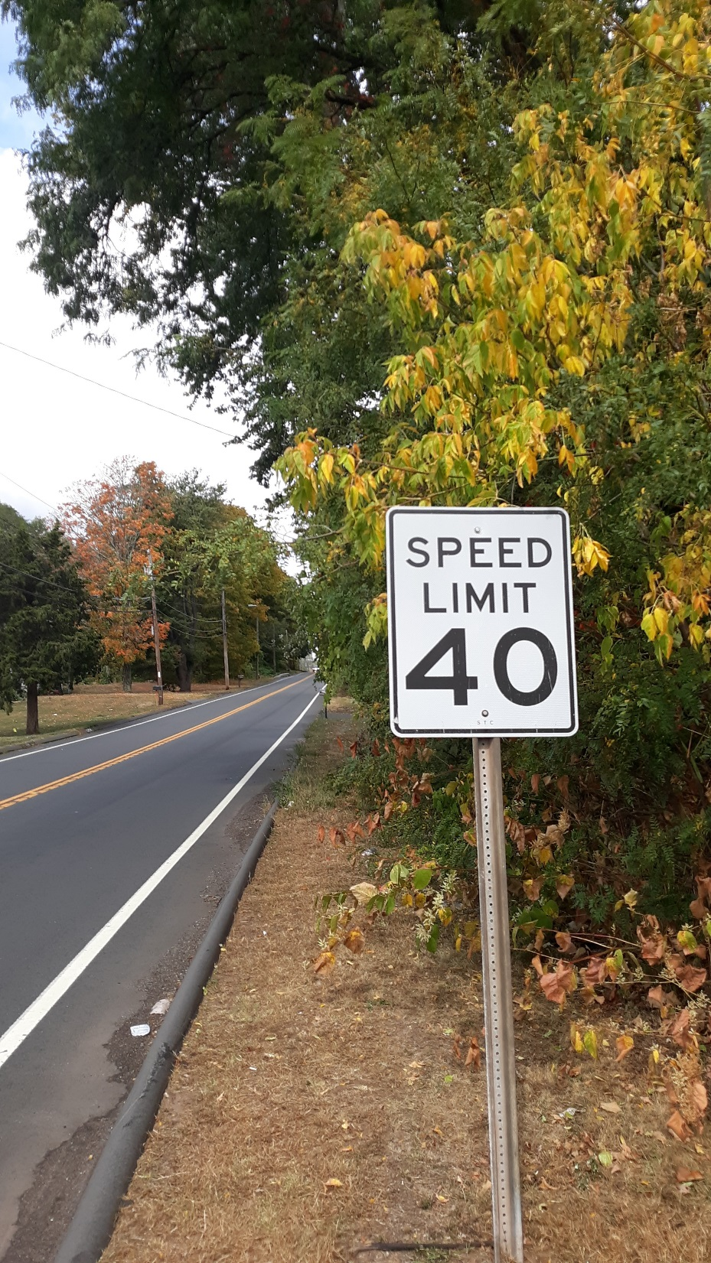
Posted 40 MPH

Slide 23
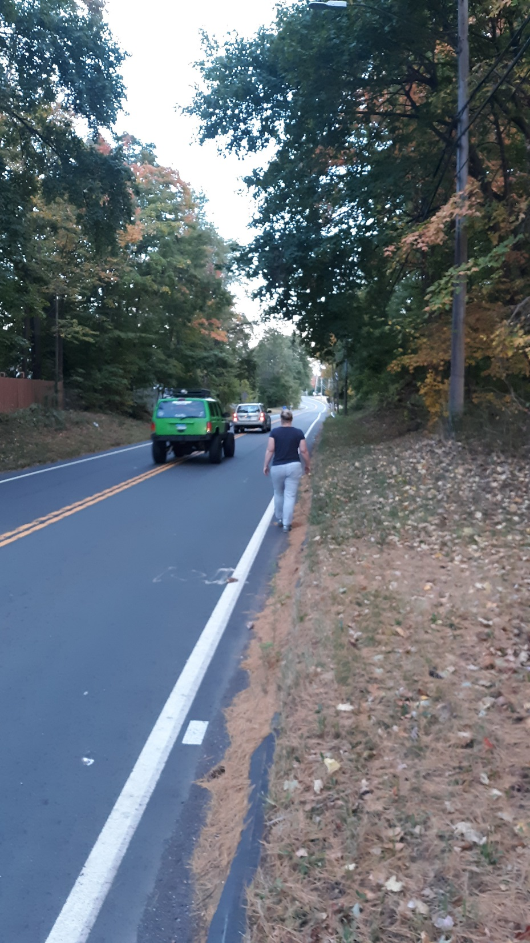
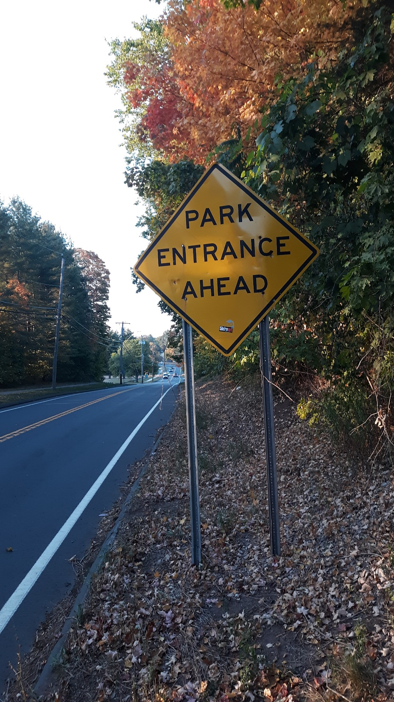
Pedestrians Share Roadway with Vehicles

Slide 24
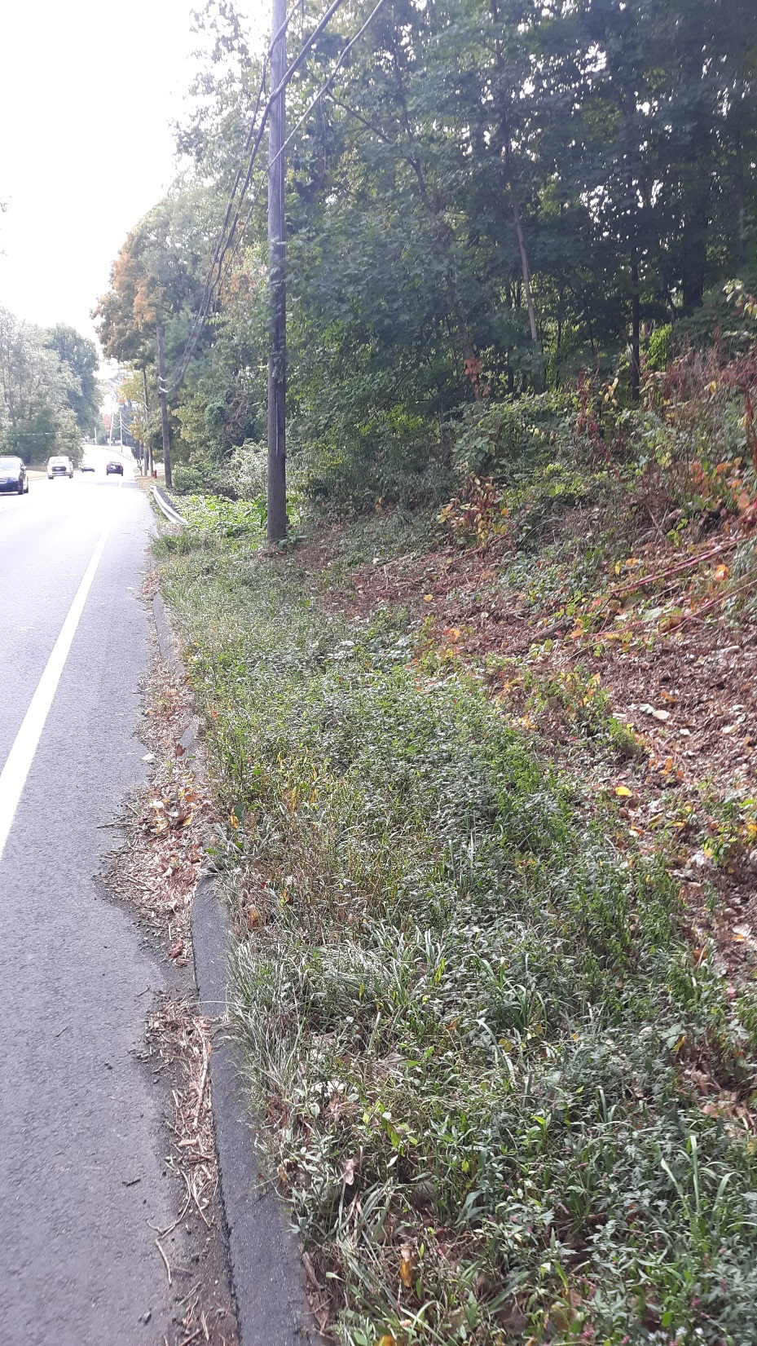
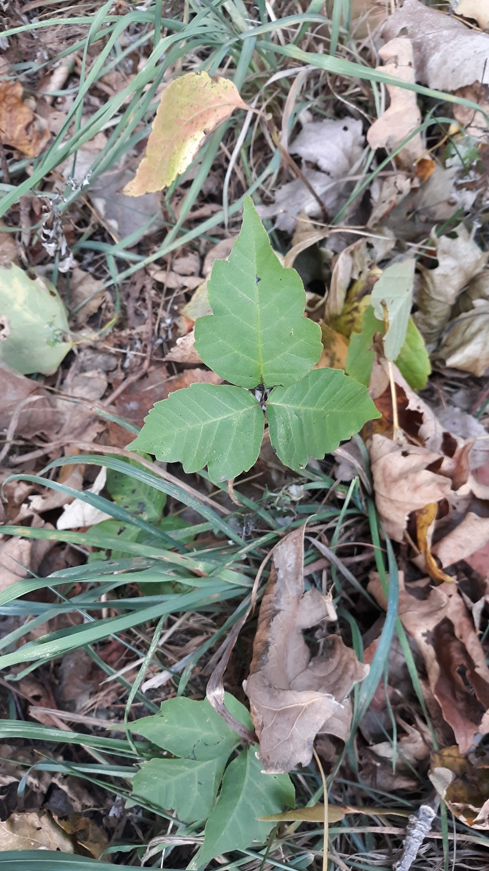
Uneven Ground Surface Covered with Poison Ivy

Slide 25
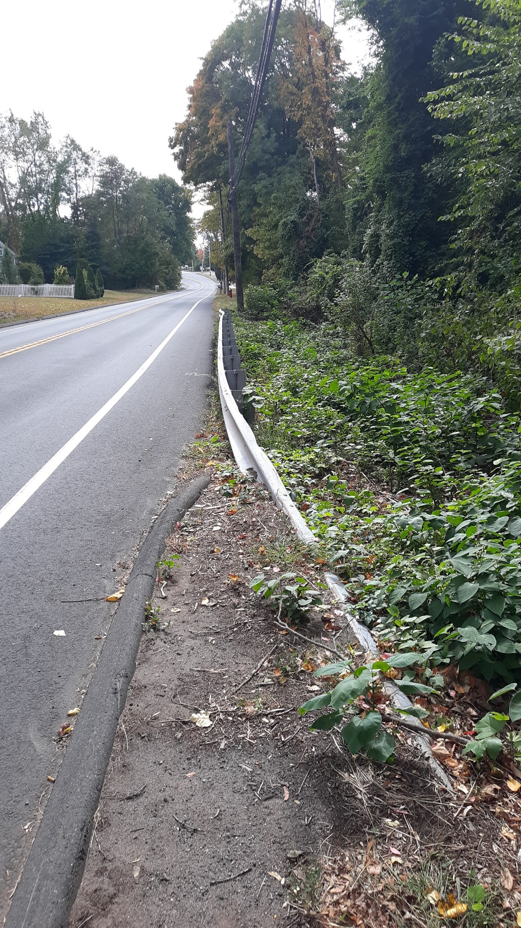
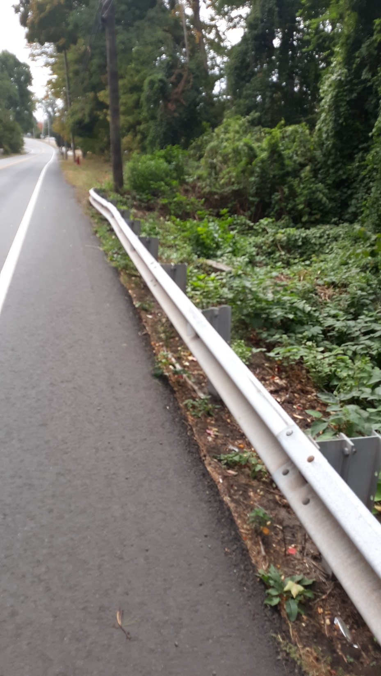
Guide Rail Along Edge of Pavement

Slide 26
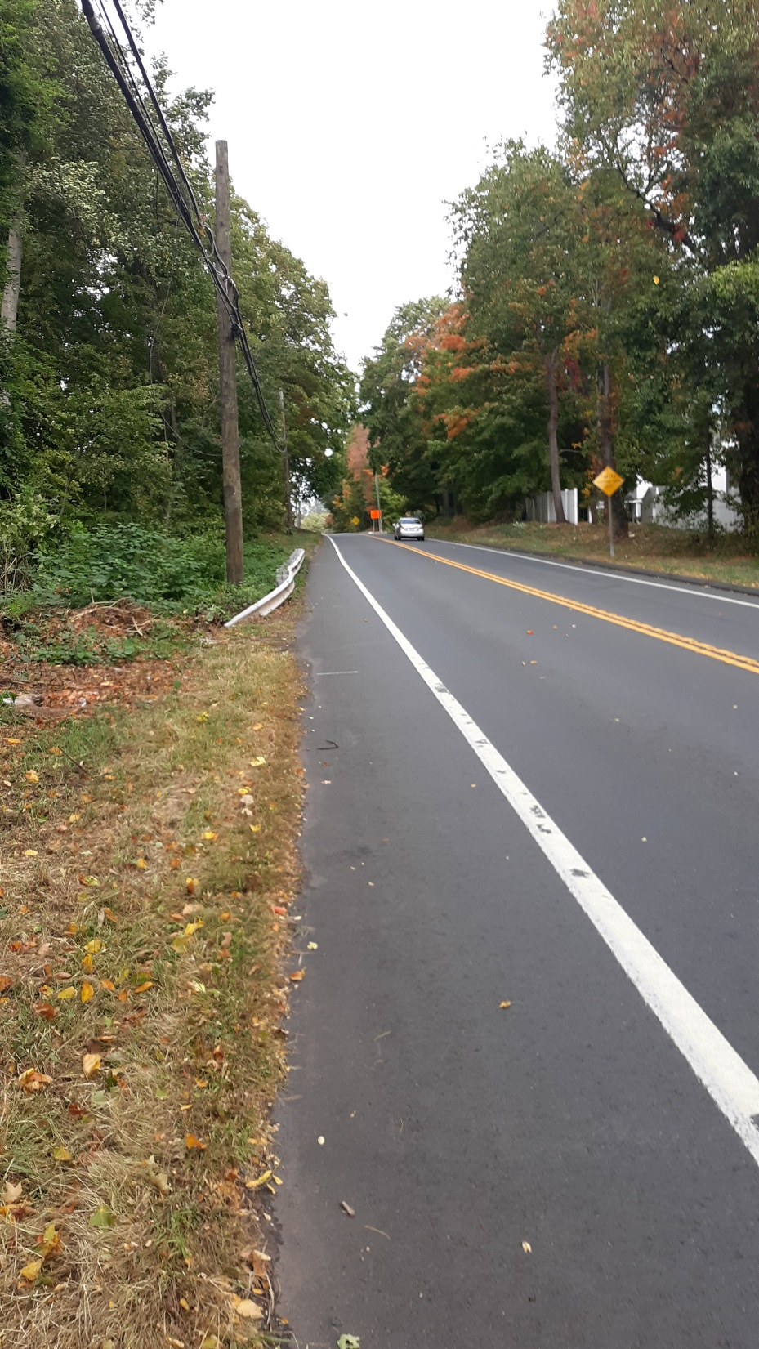
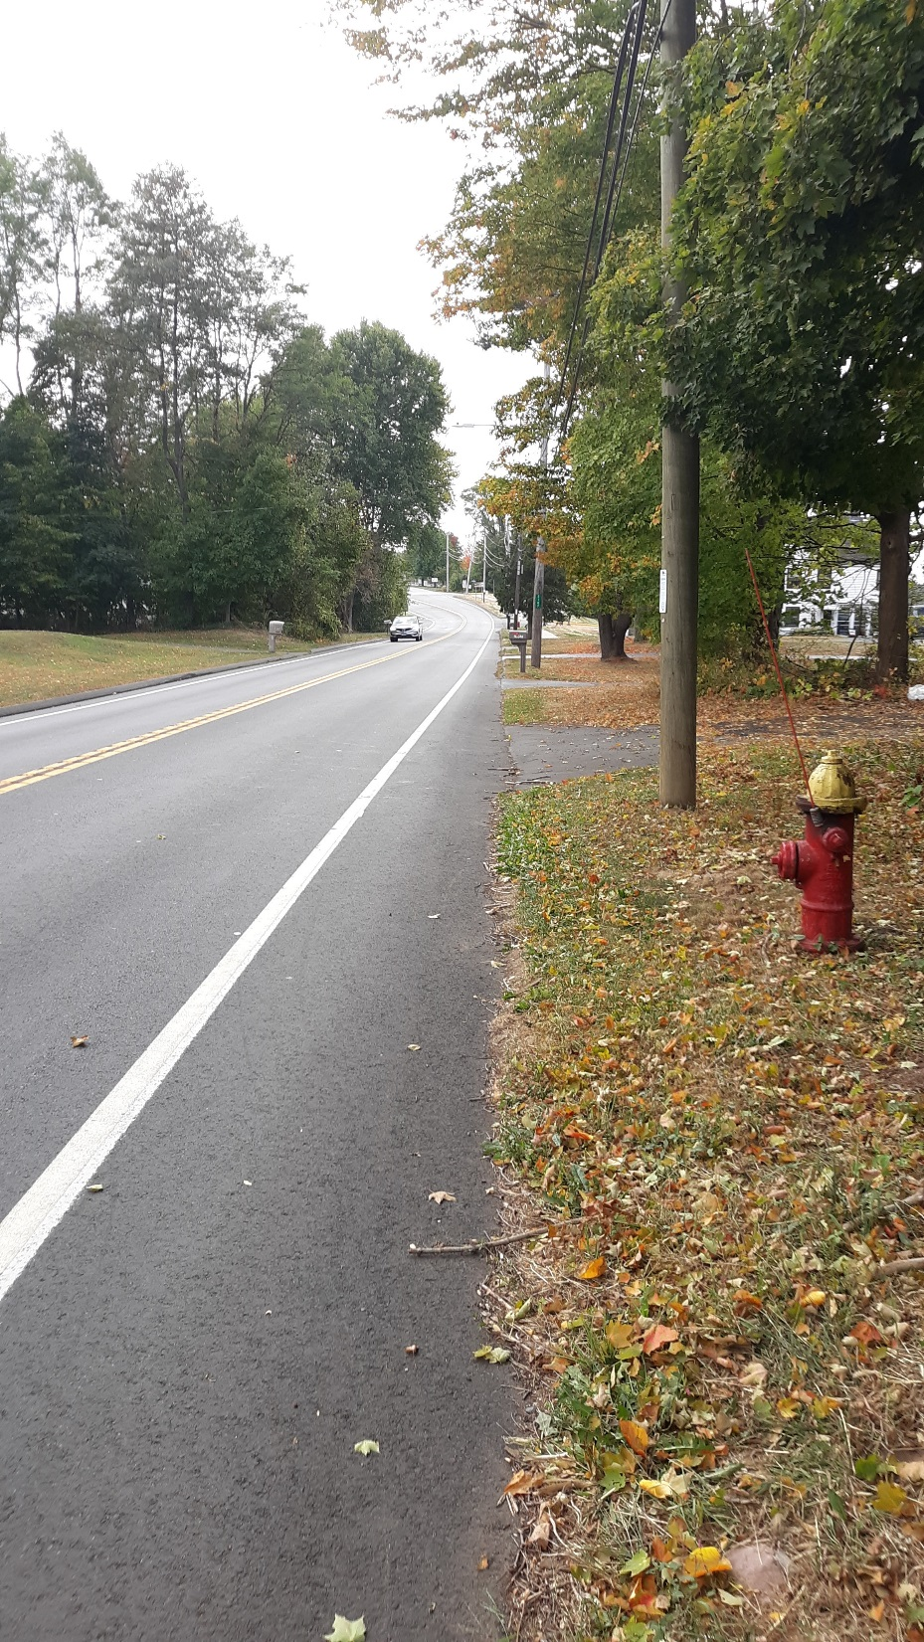
Narrow Pavement

Slide 27

PROPOSED SOLUTION
Notes:
TITLE SLIDE

Slide 28
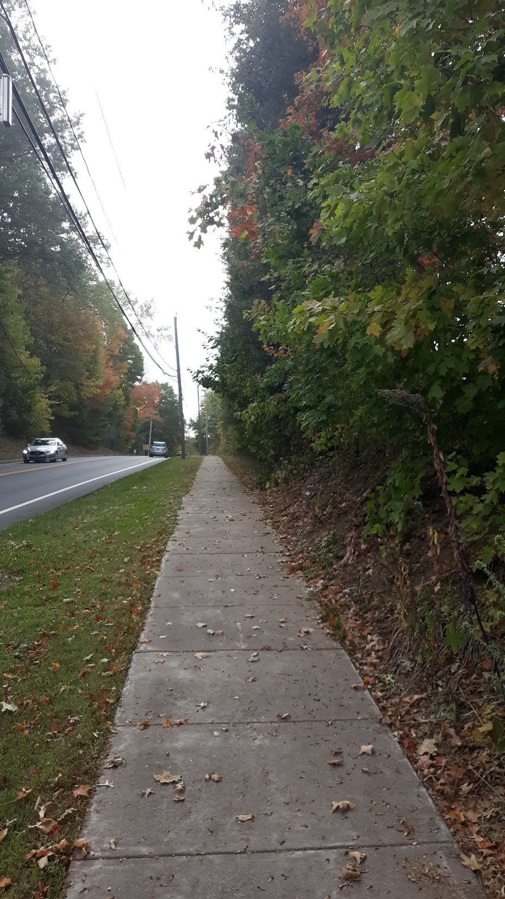
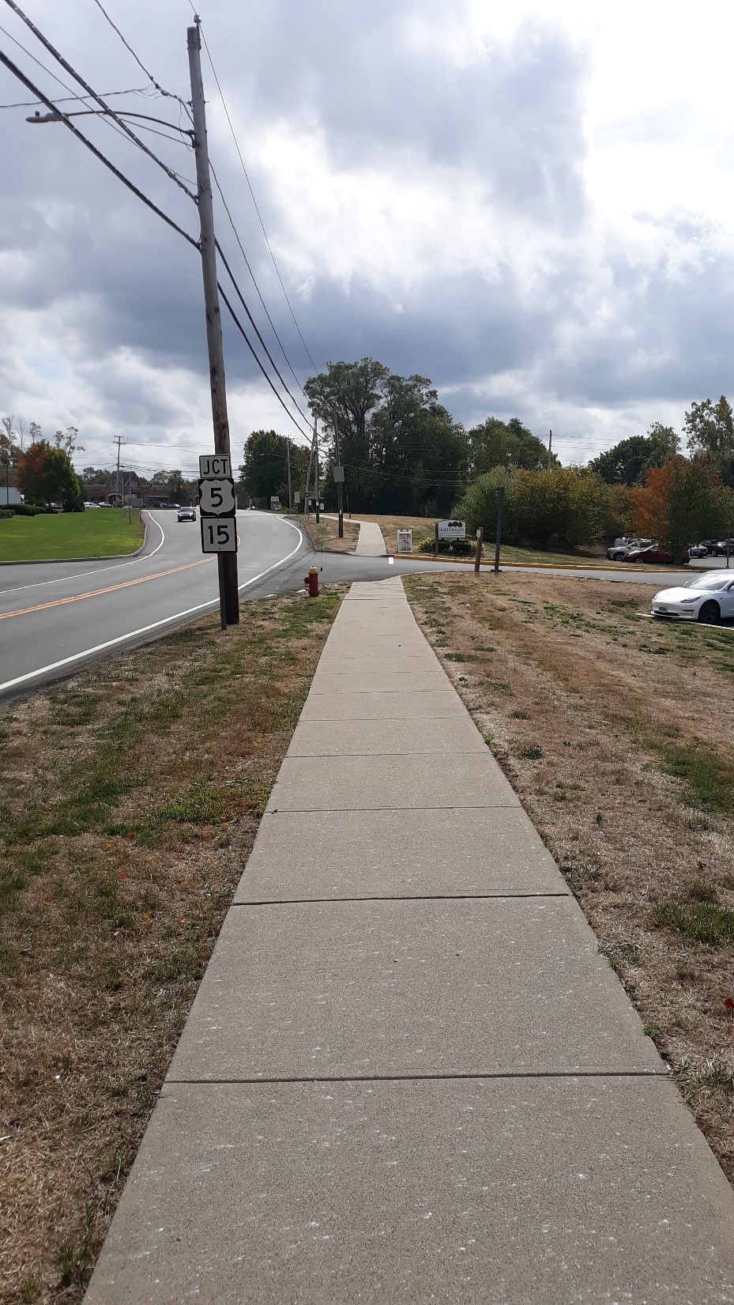
Connect
Sidewalk
Gap

Slide 29
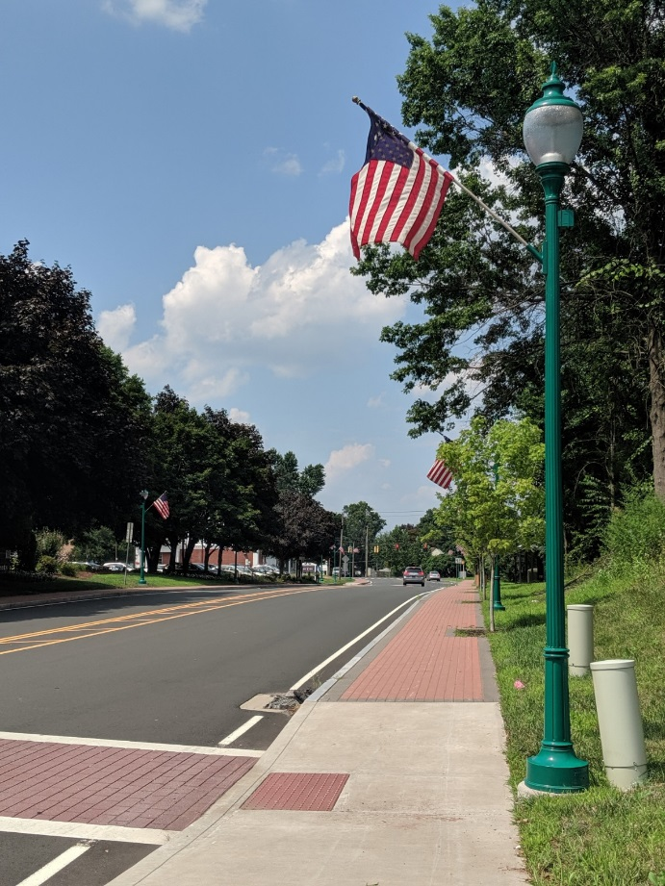
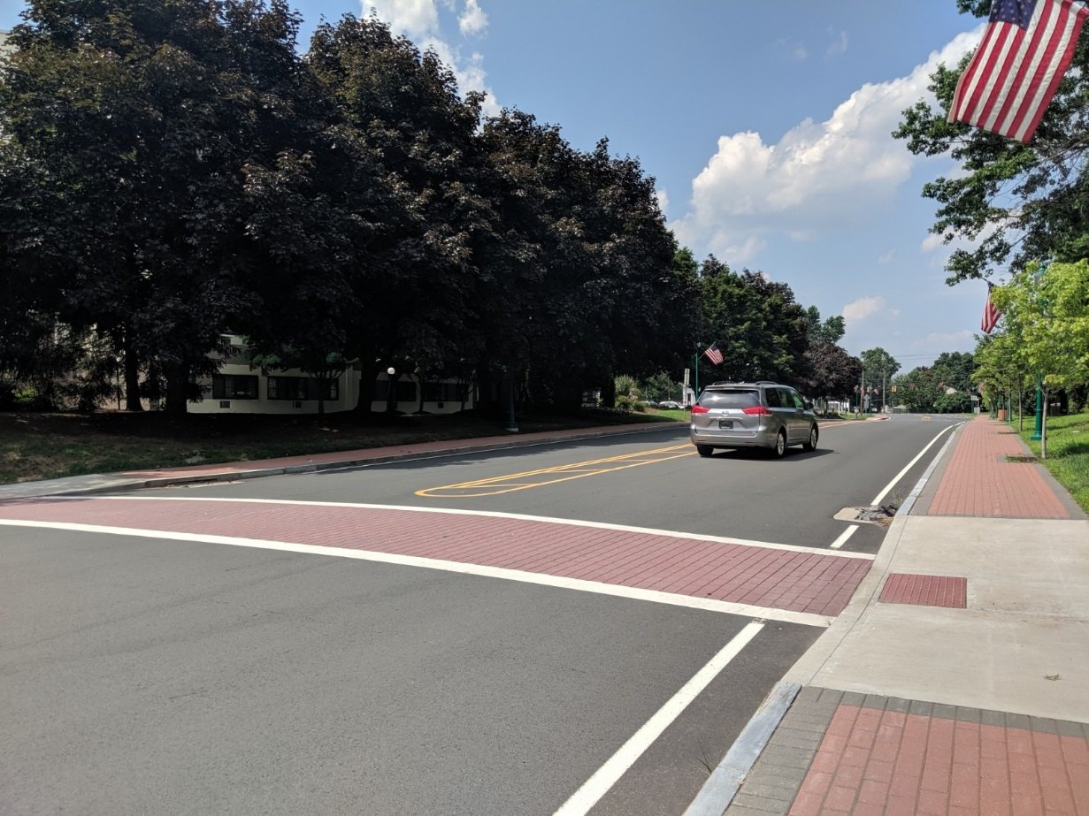

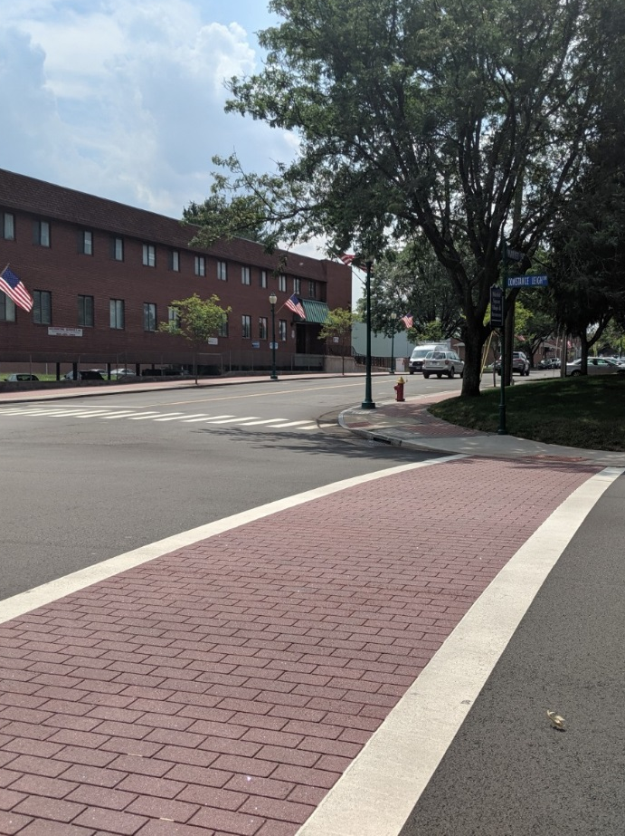
Proposed Project
NOT a streetscape project (similar to Newington Center)
New concrete sidewalk with minor corridor improvements
Notes:
ADD PICTURE OF TOWN CENTER

Slide 30
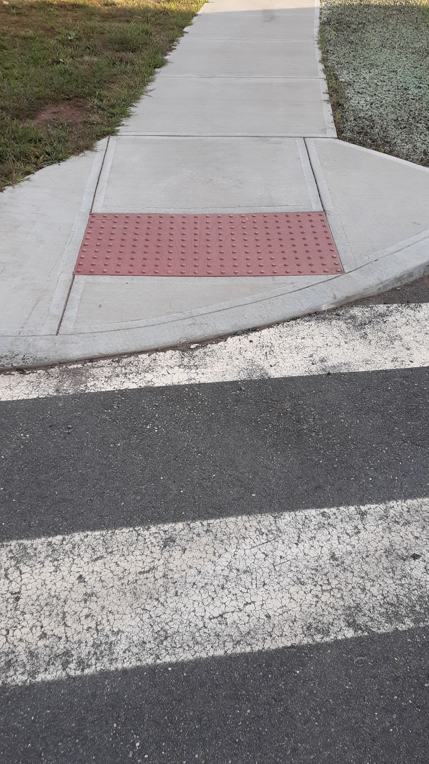
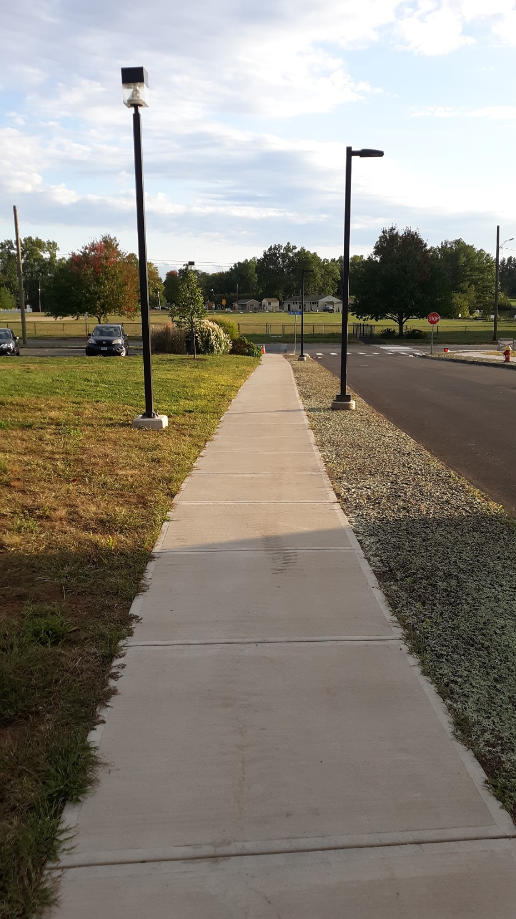
Sidewalk
Improvements
900’ New Sidewalk
Sidewalk Ramps

Slide 31
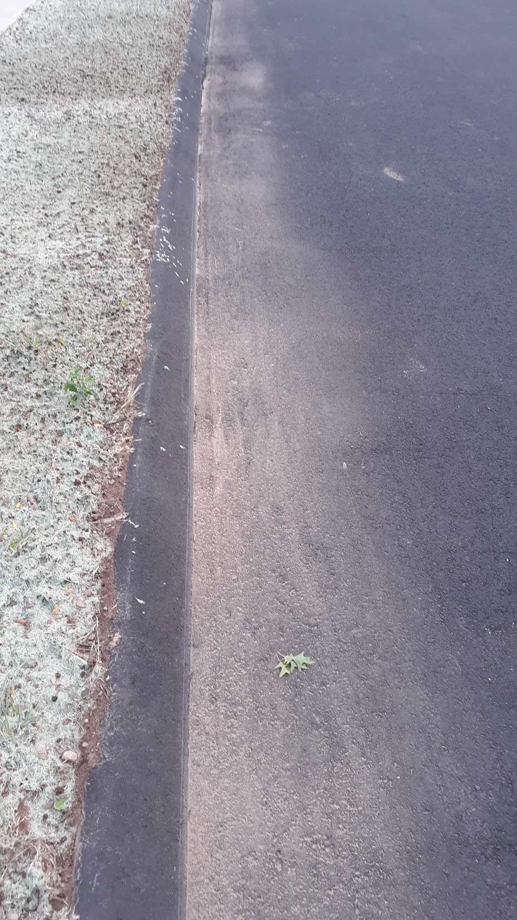
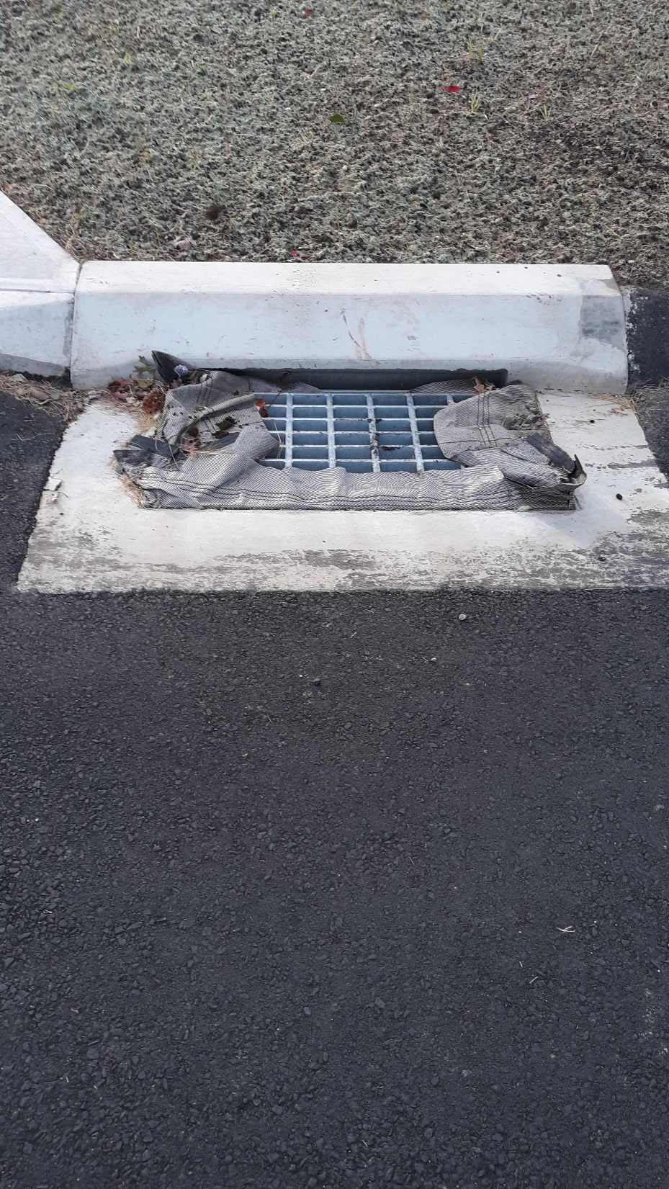
Drainage
Improvements
300’ New Curb
1 New Catch Basin

Slide 32
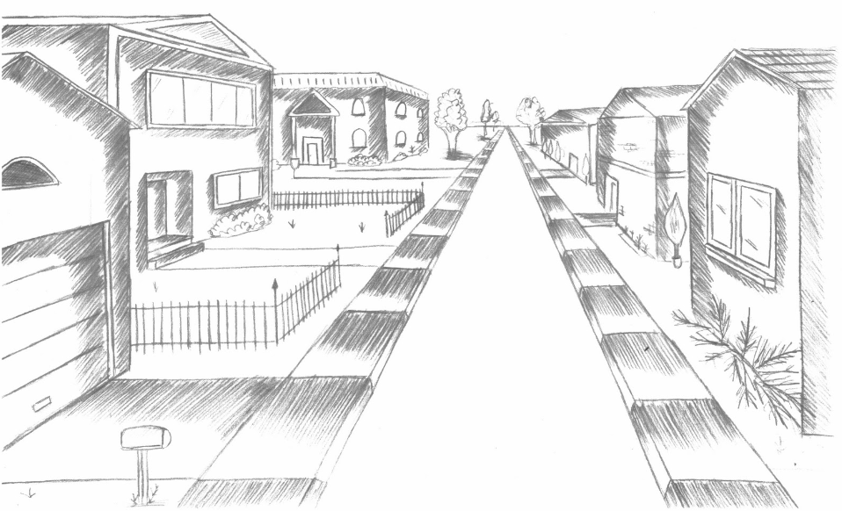
PRELIMINARY DESIGN
Notes:
TITLE SLIDE

Slide 33
Title
Main Street
Sidewalk
Connectivity
Project

Slide 34
Plans
Clearing
Sidewalk
Landscape

Slide 35
Details
Sidewalk
Sidewalk Ramp
Curb
Catch Basin
Pipe Profile
Easement

Slide 36
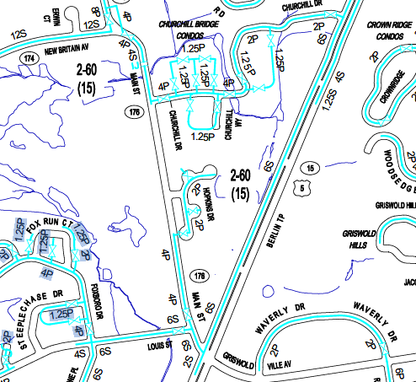
Utility Coordination
MDC – water and sewer
Eversource (CL&P) – electric
CNG – Gas
Frontier/ATT – communication
CDOT – storm water drainage

Slide 37


Engineering Design Guides

Slide 38
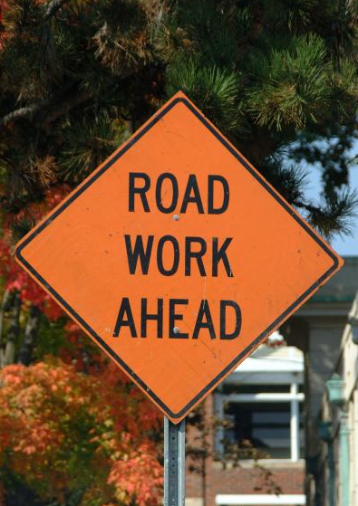
Impact to TON/residents
Southbound lane intermittent closures during construction
Minimum one lane open during construction
Maintain access to:
  TON transfer station
  Hopkins Drive
  Private property

Slide 39

FUNDING

Slide 40
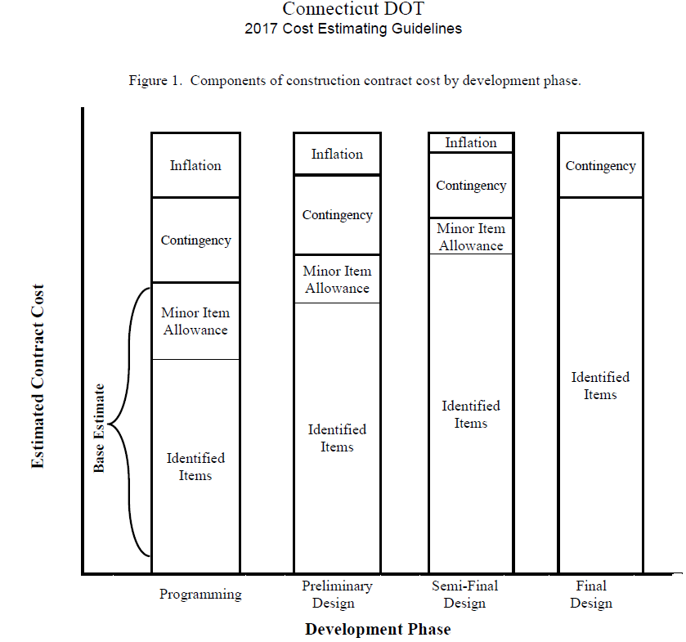
Cost Estimate
$525,000 = Total Cost
Preliminary Design
36 Major Items = $365k
Minor Item Allowance = $70k
Contingency = $45k
Incidentals = $45k
Inflation = $0k

Slide 41
Funding Sources
TON Sidewalk Maintenance CIP funds
CDOT Community Connectivity Grant funds
  Improve pedestrian safety, mobility, and connectivity
  Sidewalks connect neighborhoods

Slide 42
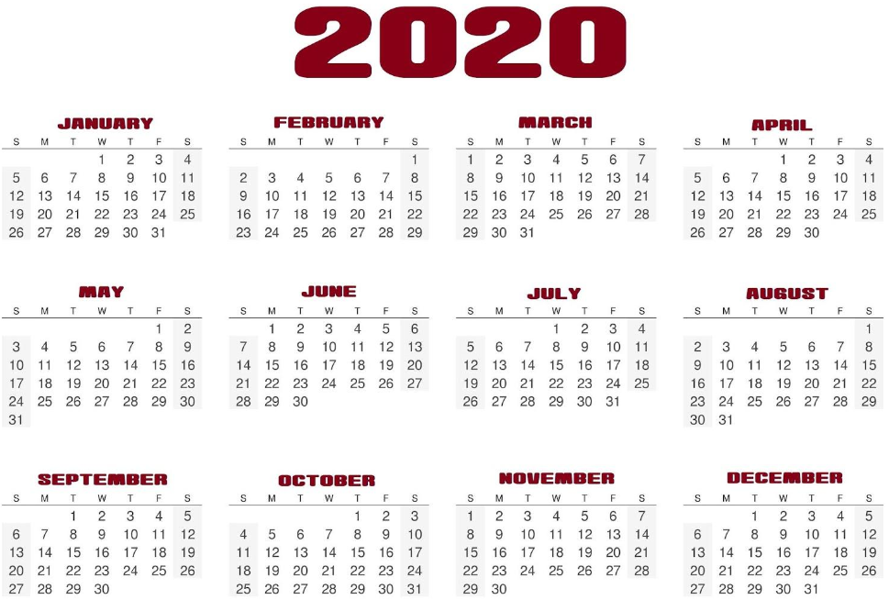
SCHEDULE

Slide 43
Grant Application Schedule
Grant Solicitation Announced – 31 AUG 2020
Public Outreach – 6 OCT 2020
Town Council Meeting – 13 OCT 2020
Application Due – 16 OCT 2020

Slide 44
Preliminary Project Schedule
Description | Duration | Estimate Date
Prepare CCGP Application | 1 month | Fall 2020
CCPG Selection | TBD | Fall 2020
Commitment to Funding | TBD | Winter 2021
Prepare Final Design | 6 months | Winter-Spring 2021
Utility Coordination | 2 months | Spring 2021
CDOT Encroachment Permit | 2 months | Summer 2021
Prepare Bidding Documents | 2 months | Fall 2021
Bidding | 2 months | Winter 2022
Select Contractor | 2 months | Spring 2022
Construction | 2 months | Summer 2022
~24 month duration

Slide 45

GRANT APPLICATION
Notes:
Title slide

Slide 46
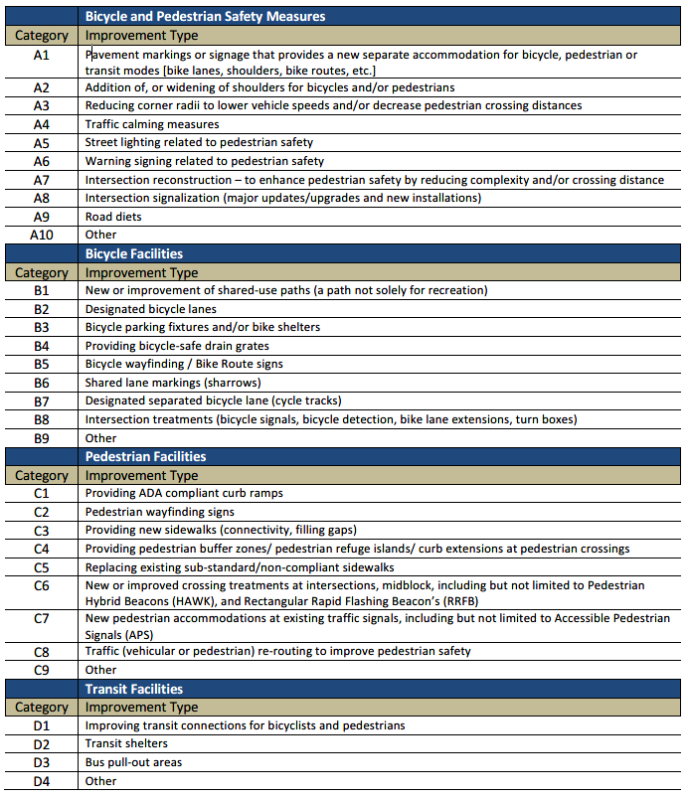
Eligible Improvements
Bicycle and Pedestrian Safety
Bicycle Facilities
Sidewalk Facilities
Transit Facilities

Slide 47
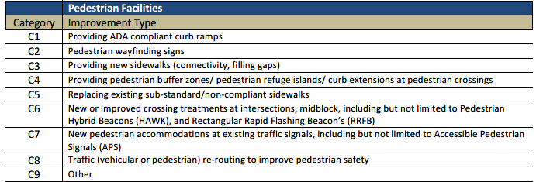
Eligible Improvements - Project

Slide 48

CCGP Application
Site Location Map
Preliminary Engineering Plans
Project Schedule
Letters of Support
Endorsement by Municipality
Description of Project
Safety and Accessibility
Transportation Equity
Cost Estimate

Slide 49
CCGP Application – Letter of Support/Opposition
Town Engineer
  Gary Fuerstenberg, PE
  200 Garfield Street Newington CT 06111
  gfuerstenberg@newingtonct.gov
Town Planner
  Craig Minor
  200 Garfield Street Newington CT 06111
  cminor@newingtonct.gov

Slide 50

Closing
Discussion
Comments

Slide 51
Public Comments
Within Zoom™ application “Raise Hand” if you would like to participate during Public Participation.
If calling into Zoom Meeting by telephone dial *(star) 9 to “Raise Hand” to be recognized.
Toll Free #’s (888) 788 0099 or (877) 853 5247
Webinar ID : 829 9046 8730#
Password: 649489#

